Slide 1
Exactcure
Yunyi Gao Internship Project Record

Slide 2
1.1Automation of literature mining extract drug rCP from solidarites-sante.gouv.fr------Excel----word
RCP Extract
3.1 RCP index-CSV urls
1 RCP-Excel(IDs)
RCP index(CSV)
3.2 CSV-Excel(RCP)
3.3 CSV-Excel(RCP)-txt(name_list)
4.1 CSV-Excel(RCP)-more info
Name list(txt)
4.2 Excel-Word

Slide 3
1.2Automation of literature mining search of papers based on drug substance from PubMed and returned them in excel format
PubMed
Article
Search
5.1 PubMed(key-in)-Excel-more info
5.1.1 PubMed(key-in,DOI)-Excel
2 PubMed-Excel(key-in)
5.2 PubMed(txt,PMID)-Excel

Slide 4
4.Knime workflow construction
3.Construction of SQL database structure
Knime Workflow
SQL server
6.1 Excel-SQL
6 construct SQL on SSMS
6.2 SQL-graph
7.Construct Knime Workflow
7.1 Python node-graph

Slide 5
Overview Duration: 18 June 2018 to 31 August 2018 --The following are task list with brief description. --Those with ‘**’ are non-python code, the rest are python code --Those with ‘##’ .are optimal method for its category. --The index number of each task is corresponding to the index of the code.
:
Automation of literature mining
1) subtract pharmacokinetic section from RCP from ‘base-donnees-publique.medicaments.gouv.fr’ based on random IDs loop---return to excel
2) search of papers based on drug substance name and keywords (key in at prompt) from PubMed and return [article title, author, abstract,link] in excel
3.1)get all the drug names and corresponding RCP link from ‘base-donnees-publique.medicaments.gouv.fr’ return both in csv file ##
3.2)request links in 3.1)csv file, return drug name, substance, RCP pharmacokinetics section, return in excel
3.3) from 3.1)csv file, string manipulation return drug name, substance name to excel file and put all active substance name in a txt file without repetition ##
4.1)request links in 3.1)csv file, return drug name, substance name, drug composition, drug form, RCP pharmacokinetic section, return all in excel##
4.2)transform information in 4.1)excel to word document one word document per drug , save under the name of each drug ##
5.1)search PubMed articles about substance written in a txt file, return substance name, keyword for search, article title, author, link,abstract, date of search return in excel
5.1.1) )search PubMed articles about substance written in a txt file, return substance name, keyword for search, article title,DOI, author, link,abstract, date of search return in excel, eliminate repeated articles by DOI check
5.2)search PubMed articles about substance written in a txt file, return substance name, keyword for search, article title,PMID,DOI, author, link,abstract, date of search return in excel, eliminate repeated articles by PMID check in single substance database ##
Construction of SQL database structure
6)Build SQL database on both local server and remote server (SQL server Mattieu) using SSMS** ##
6.1)Populate the SQL database(local/online) from excel ##
6.2)Generate math model of drug intake from request from SQL database ##
Knime workflow construction
7)Build knime workflow to connect online/local SQL server and populate the SQL database and retrieve info and generate equation model ** ##
7.1)Python extension and code to generate a graph of RCP modelling ##

Slide 6
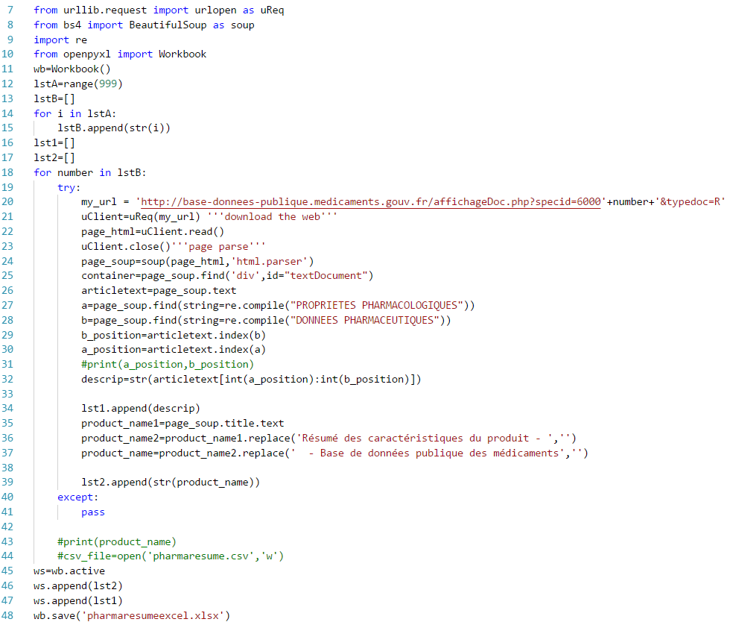
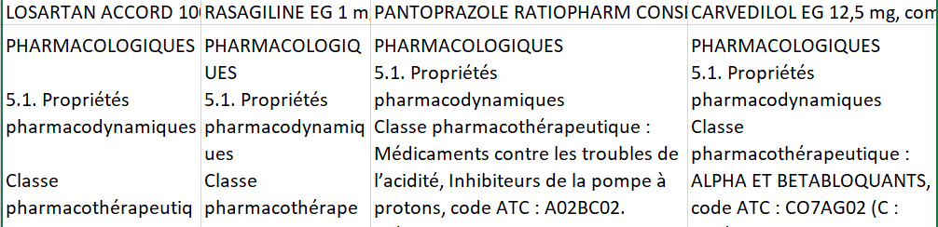
Automation of literature mining 1) subtract pharmacokinetic section from RCP from ‘base-donnees-publique.medicaments.gouv.fr’ based on random IDs loop---return to excel
Input=IDs
This code is named as’1)resume extract’
Line 12: form a list of numbers, the ids you want to search, which will sub into line 20,the id of the link to request.
Can change the number after ’specid=‘ to make change in IDs
The result will be returned in excel named ‘pharmaresumeexcel.xlsx’
Output=excel

Slide 7
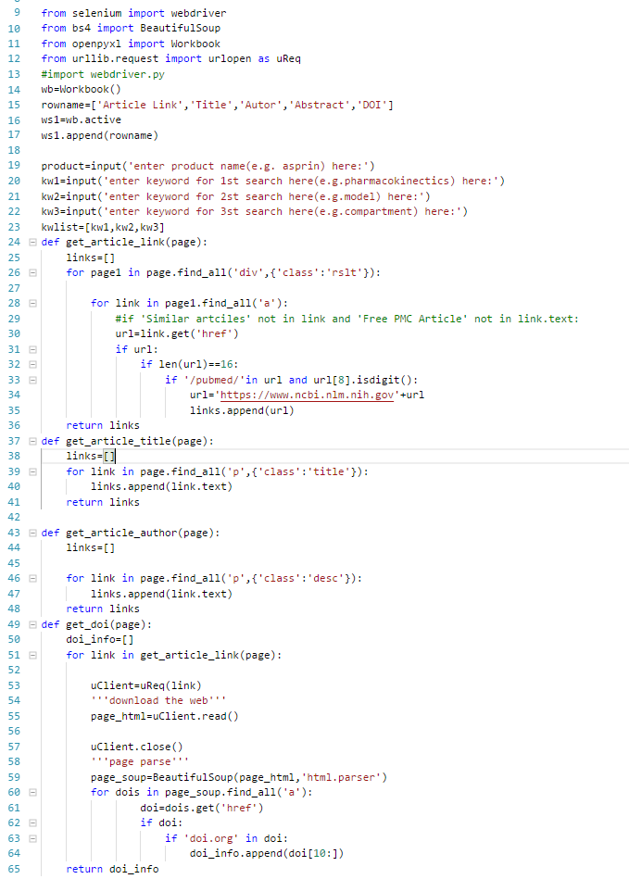
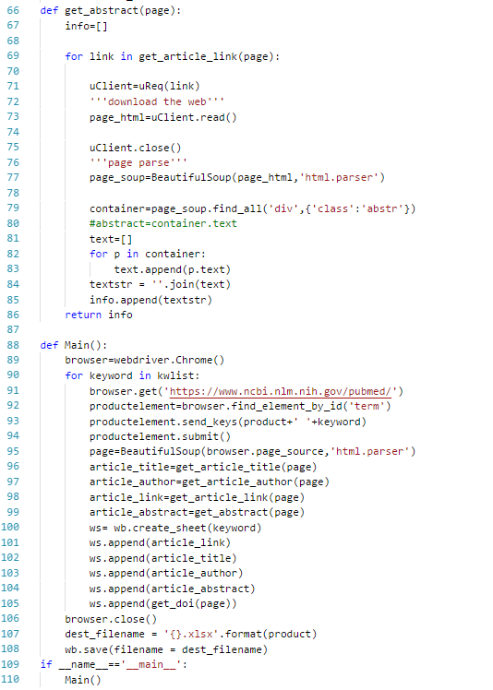
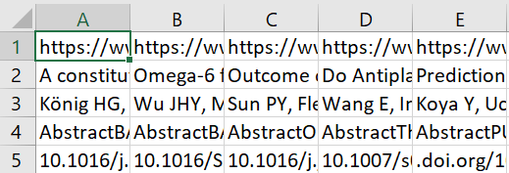
Automation of literature mining 2) search of papers based on drug substance name and keywords (key in at prompt) from PubMed and return [article title, author, abstract,link] in excel
Input=key-ins
This code is under name ‘2)final pubmed’
Line 91 to 94 is chrome webdriver form submission function to submit some string to the search bar. Webdriver needs to be downloaded to make this work.
Line 19 to 23 is to manually key in the substance name and keyword. You can run it from prompt. Or IDE like spyder.
This code will return an excel named under the substance name you key in and the excel will contain info of the articles from your search on pubmed.
Output=excel e.g.’Asprin.xlsx’

Slide 8
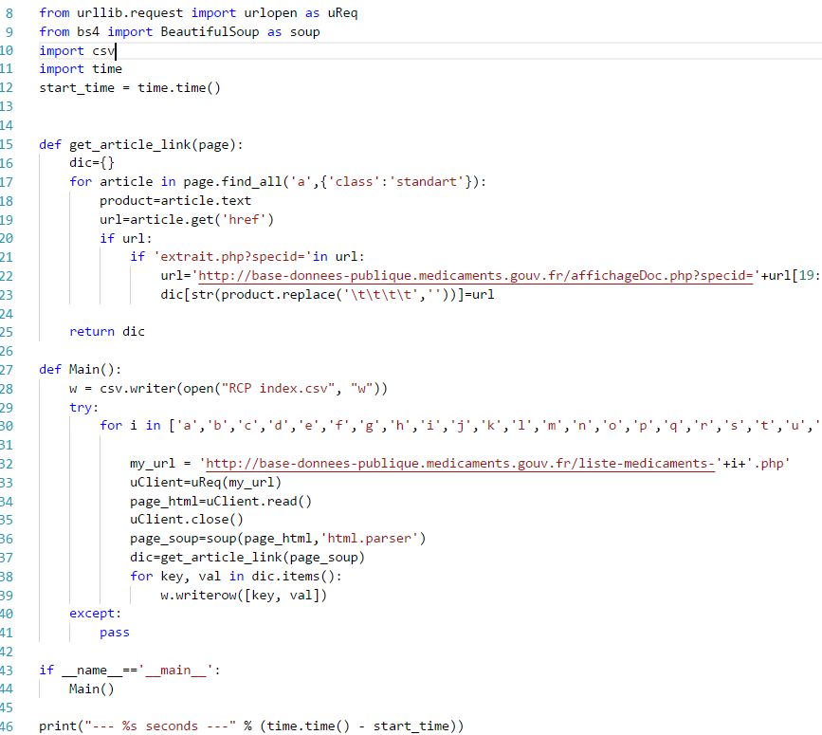
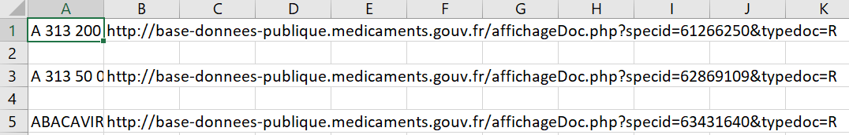
Automation of literature mining 3.1)get all the drug names and corresponding RCP link from ‘base-donnees-publique.medicaments.gouv.fr’ return both in csv file
This code is named under ‘ 3.2)RCP index’
Line 32, direct to the index page and by alphabetic sequence, copy all the drug name and its RCP link.
Return the result to ‘RCP index.csv’
Output= ‘RCP index.csv’
Input=links

Slide 9
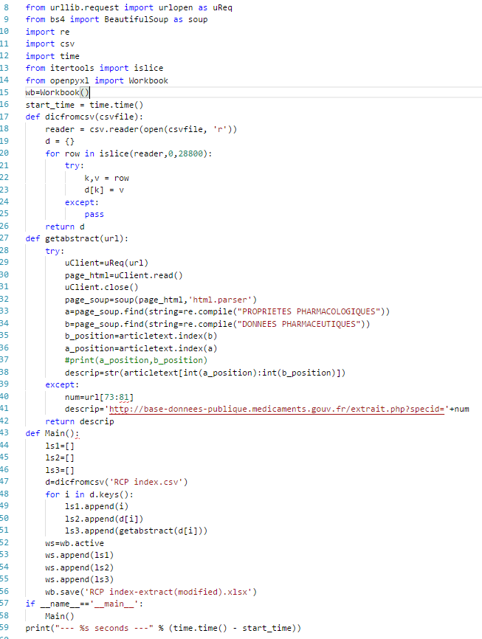
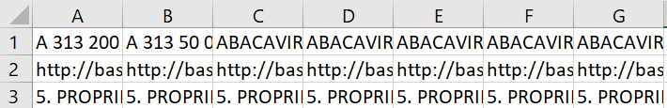
Automation of literature mining 3.2)request links in 3.1)csv file, return drug name, substance, RCP pharmacokinetics section, return in excel
input= ‘RCP index.csv’
This code is named under ’3.1) RCP abstract’
It will loop through all the links in ‘RCP index.cvs’ and return an excel of all drug name and other RCP info.
It will return an excel under the name of ‘RCP index-extract(modified)’
output= excel

Slide 10
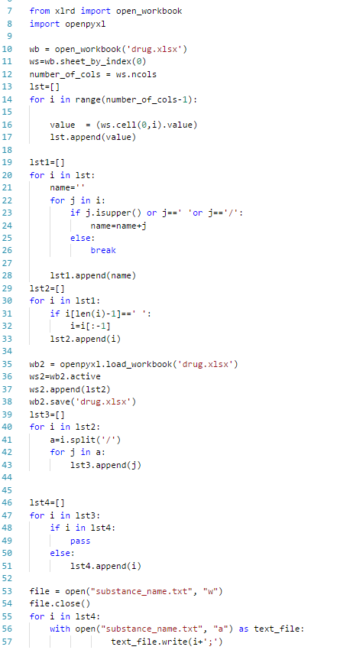
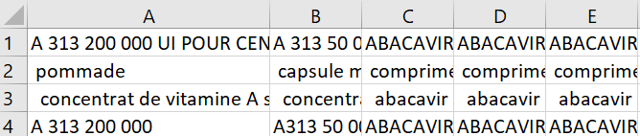
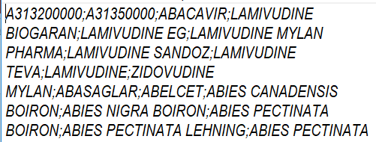
Automation of literature mining 3.3) from 3.1)csv file, string manipulation return drug name, substance name to excel file and put all active substance name in a txt file without repetition
The code under the name’3.3)rcp index to name list’ is a code simplified from the ‘3.1)RCP abstract’ to return a simpler excel file of all the existing drug name and substance composition into a new excel called ‘drug.xlsx’
The code under the name’ 3.3.1)active substance ’. First it does string manipulation to separate the substance from the composition section and return al active substance in a new substance_name.txt’file. Second, it append a new row with the substance name under the drug name accordingly.Also, it will return a txt file of all the active substance.
This will be used in the future SQL ‘drug_name to substance_name’table population.
Output 1= excel
Output 2= txt

Slide 11
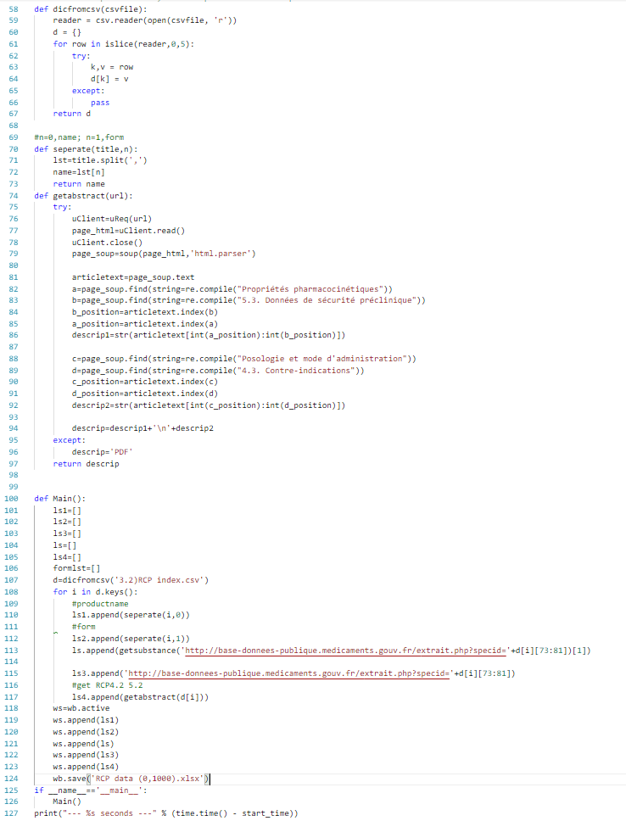
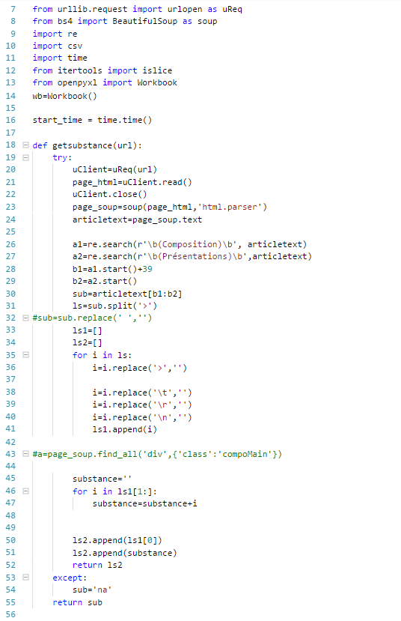
Automation of literature mining 4.1)request links in 3.1)csv file, return drug name, substance name, drug composition, drug form, RCP pharmacokinetic section, return all in excel
This code is stored under the name of ‘4.1) RCP database-excel’.
The links from 3.1)csv file are visited and return an excel of info about the substance.
Input = csv
Output = excel

Slide 12
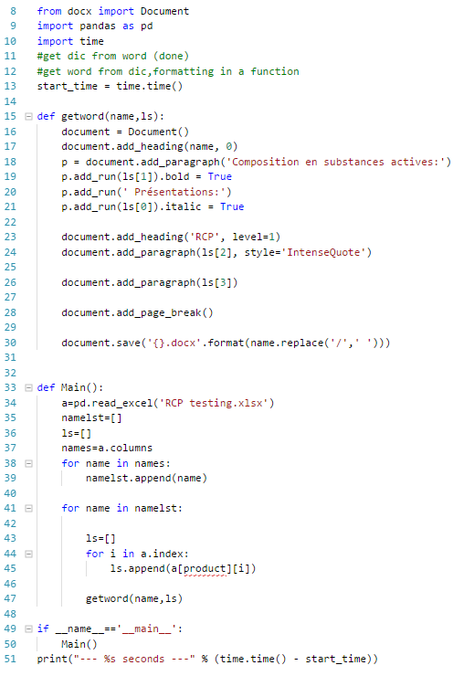
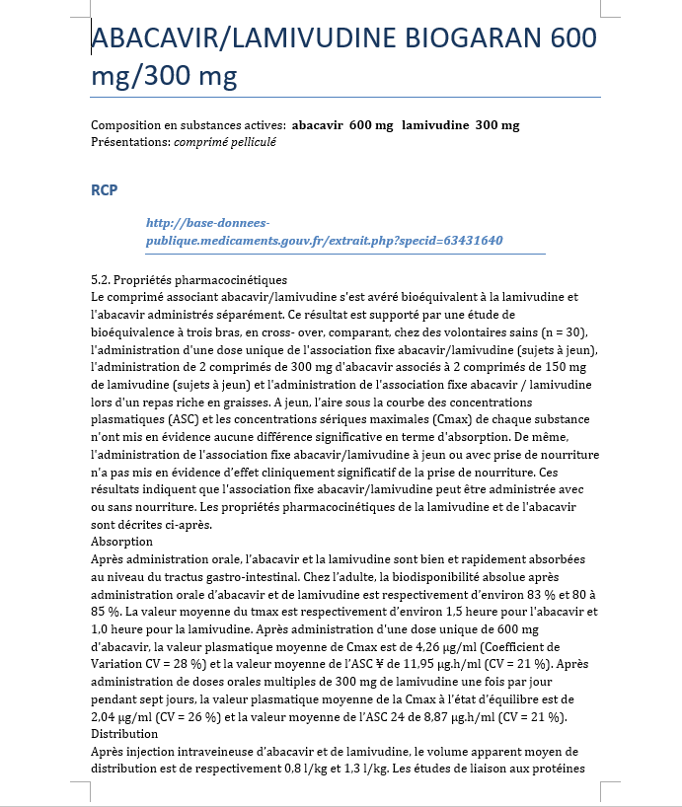
Automation of literature mining 4.2)transform information in 4.1)excel to word document one word document per drug , save under the name of each drug
This code is named as ‘4.2)excel---word’
The info of each substance in the excel will be further transformed to word document.
The right is a sample.
Info like drug name, active substance composition and drug form and RCP pharmacokinetic section will be presented.
Output = word
Input = excel

Slide 13
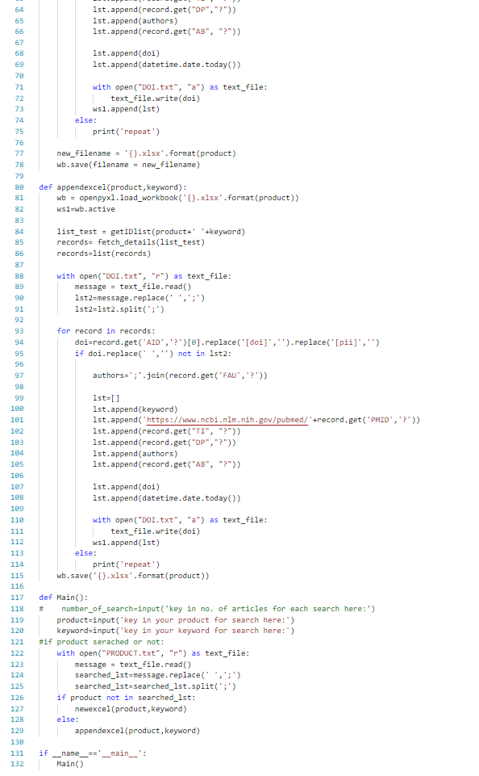
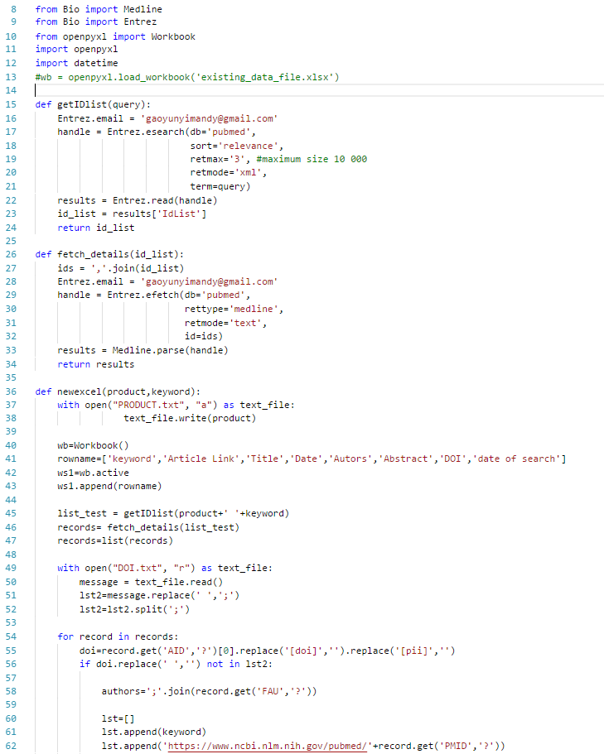
Automation of literature mining 5.1)search PubMed articles about substance written in a txt file, return substance name, keyword for search, article title, author, link,abstract, date of search return in excel 5.1.1) )search PubMed articles about substance written in a txt file, return substance name, keyword for search, article title,DOI, author, link,abstract, date of search return in excel, eliminate repeated articles by DOI check
The two code are stored under the names of ‘5.1)pubmed xml’ and ‘5.1)pubmed xml(DOI)’
The second one is the improved version form the first one by checking DOI to prevent same article to be stored.
Two txt files need to be created.
‘PRODUCT.txt’ is to keep track of the product you already searched. So that articles under the same substance will be stored under the same excel file. While those not searched will be stored in new excel.
‘DOI.txt’ is created to stored article doi that you already stored,thus no repetitive article will be stored.
The search keywords have to be keyed in manually when running this program.

Slide 14
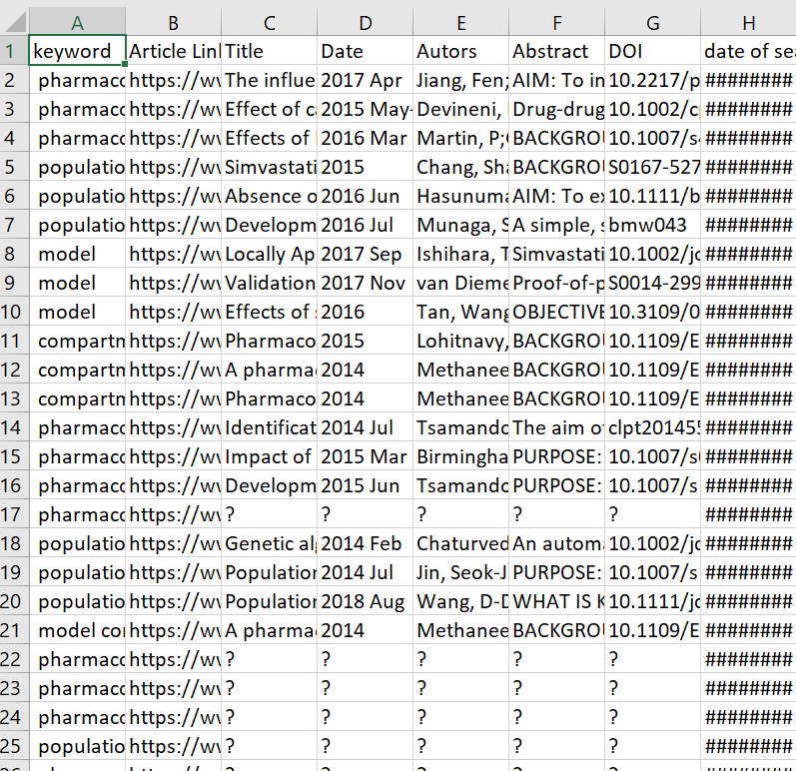
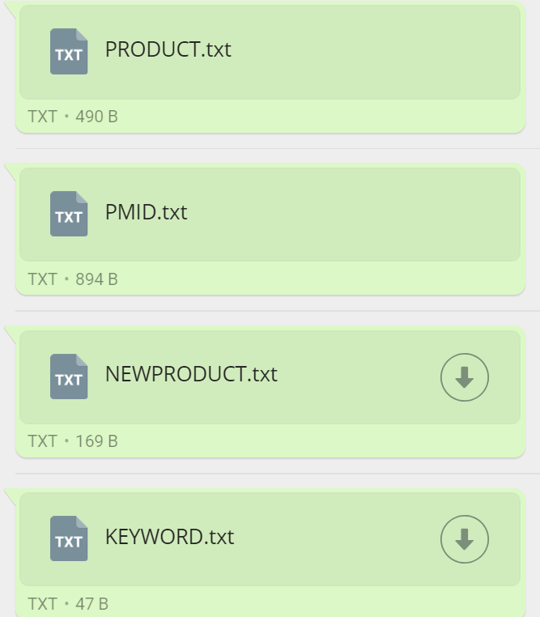
Input = txt
output = excel

Slide 15
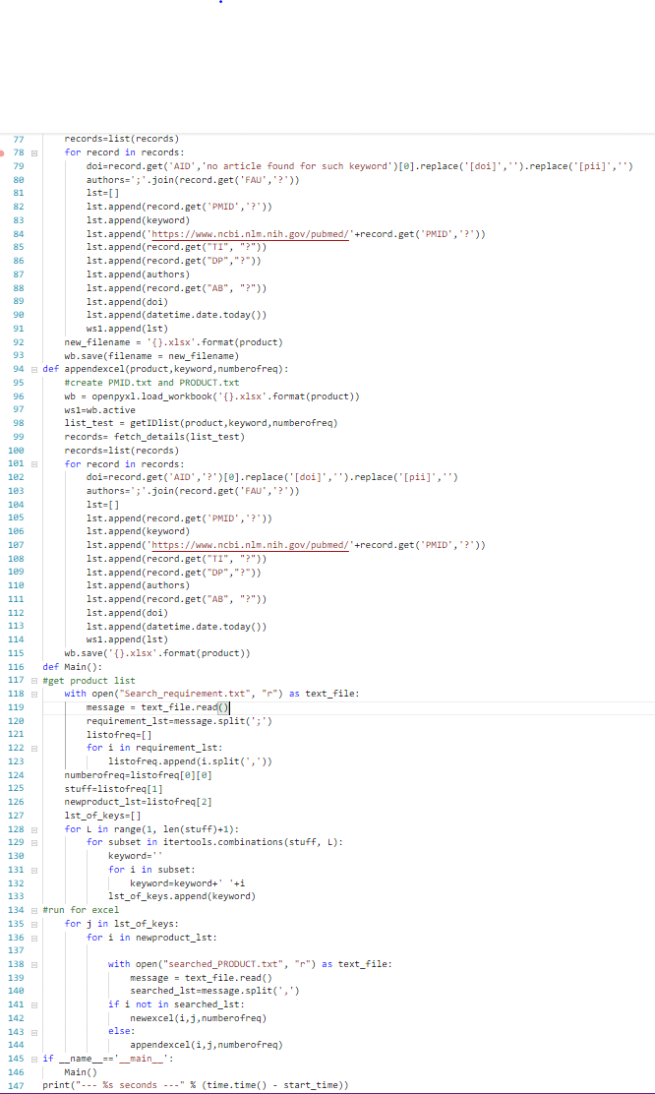
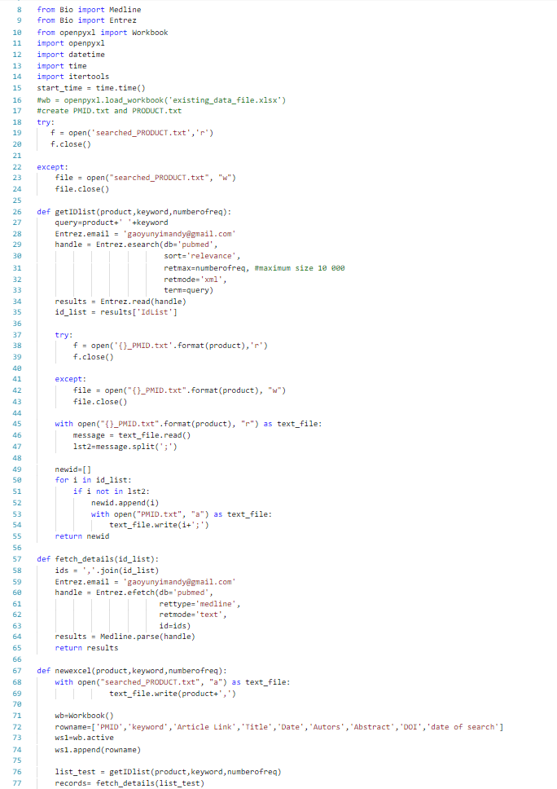
Automation of literature mining 5.2) )search PubMed articles about substance written in a txt file, return substance name, keyword for search, article title,PMID,DOI, author, link,abstract, date of search return in excel, eliminate repeated articles by PMID check in single substance database
This code is stored under the name of ‘5.2)pubmed xml(PMID)’. It is code improved from 5.1).
PMID of article is recorded instead of DOI. Repetition is checked for individual substance,not for the whole search history.One txt file of the PMID per substance searched(‘{ }_PMID.txt’) is created automatically.
You have to create one txt file to start search,’’search_requirement.txt’’.The first one is number of articles you want for each keyword, the second is the list of substance you want to search,the third is the list of keywords you want to search with. The search will run with combination of all the keywords +substance name.
Excel file under each substance name will be created automatically.If you do search on same product again, new article info will be appended to the existing excel.

Slide 16
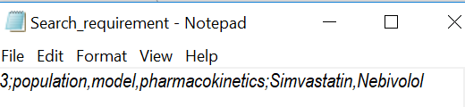
Input = txt
output = excel

Slide 17
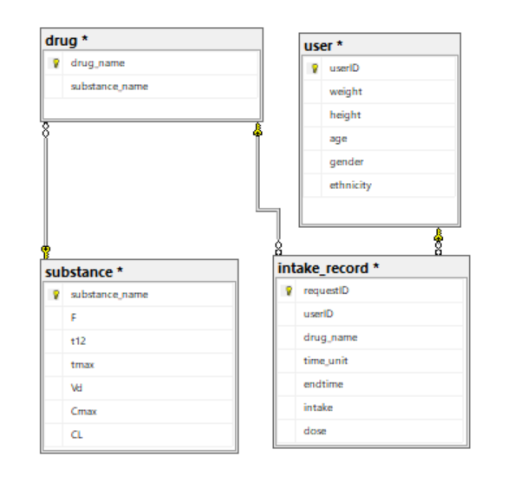
Construction of SQL database structure 6)Build SQL database on both local server and remote server (SQL server Mattieu) using SSMS
Info of online SQL server
Server name:
exactcurefirstdb.cb9zgxqtumuv.eu-west-1.rds.amazonaws.com,
Port number:1433
Login: mbexactcure
Password : ExactCurePower42
Database structure:
4 tables(primary key)
intake-_record(requestID)
Substance(substance_name)
Drug(drug_name)
User(userID)
For local server, the structure is the same

Slide 18


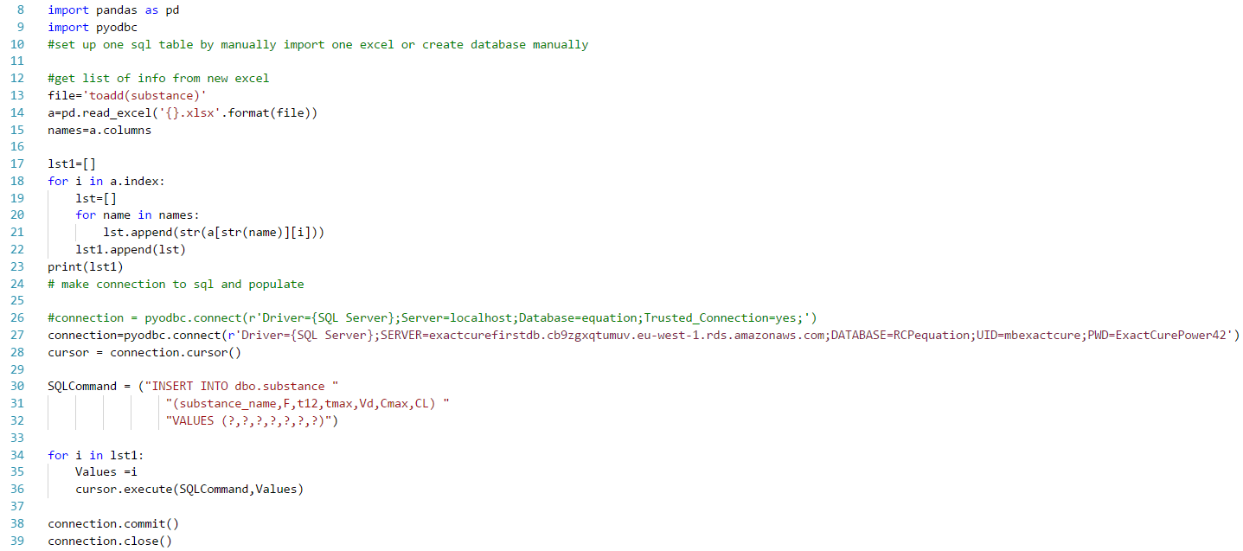
Construction of SQL database structure 6.1)Populate the SQL database(local/online) from excel
Input = excel
This code is stored under the name of ‘6.1)add_rcp(excel)_to_substance(sql)’.
You have to create one excel for each SQL table you want to append the info to (in the same format of the sql table.)
Line 27 is the connection code for online server
Comment in line 26 is connection code for local server(you can switch mode easily)
Output = populated SQL database
First line: local server
Second line: remote server

Slide 19
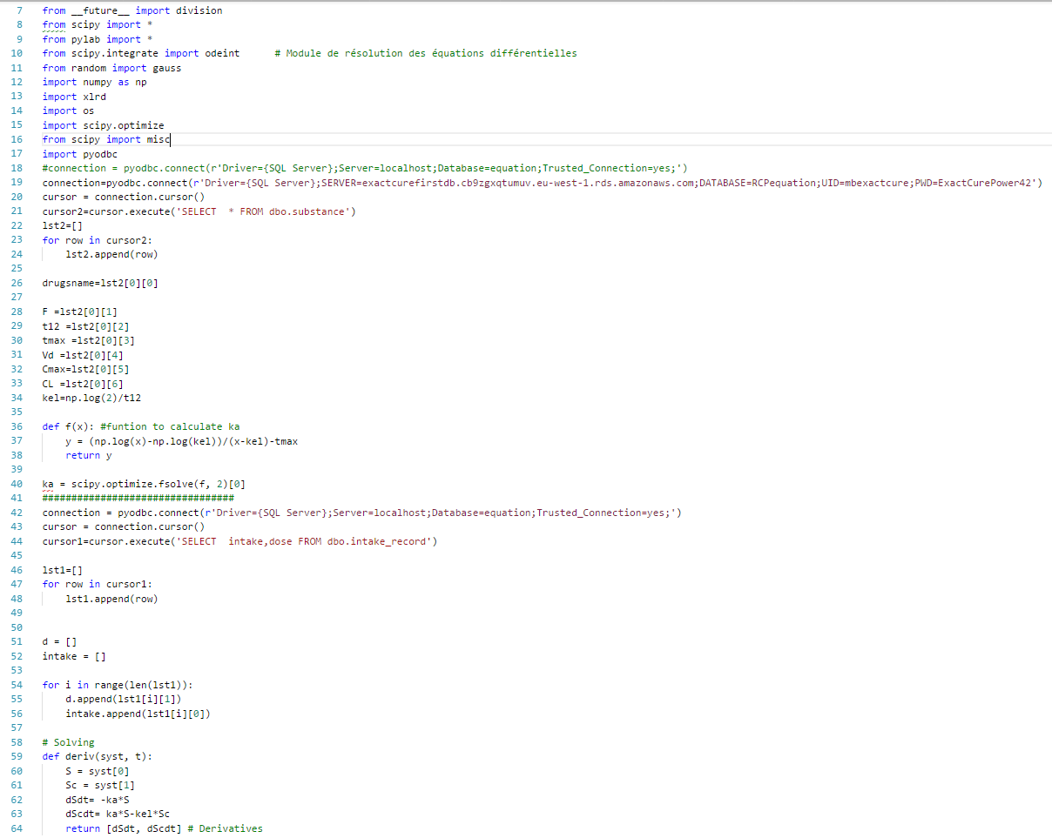
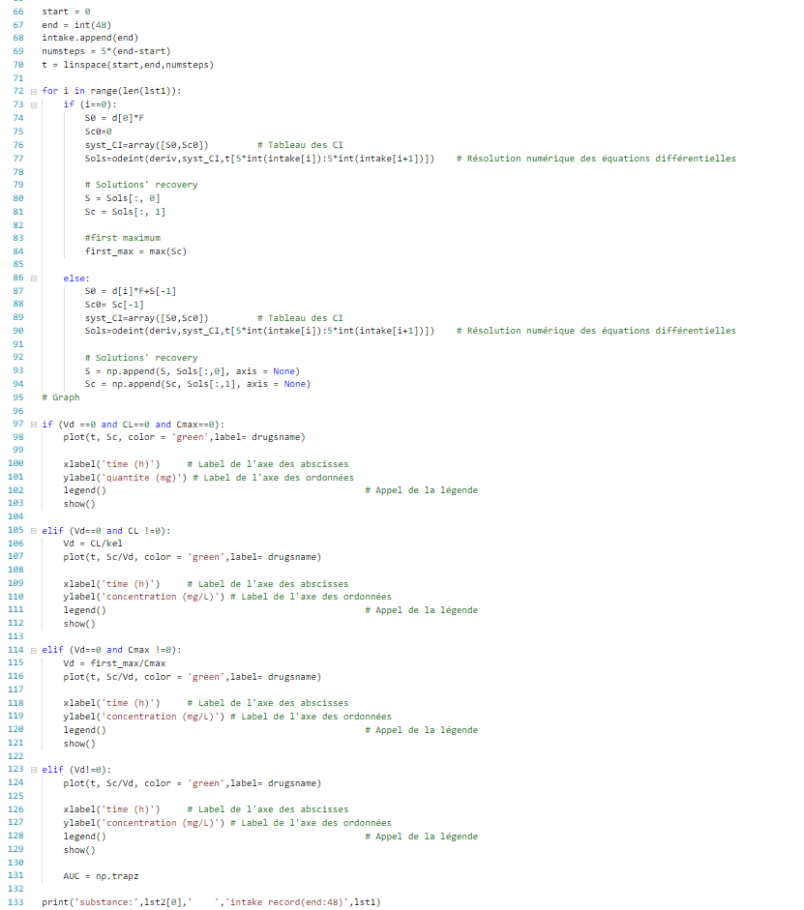
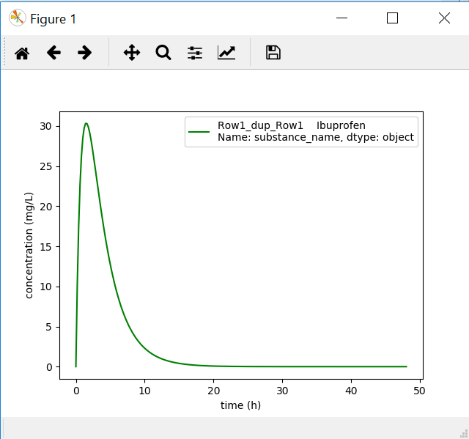
Construction of SQL database structure
6.2)Generate math model of drug intake from request from SQL database
The code is stored under the name of ‘6.2)get_equation(python)_from_sql’
Input = SQL database
First: local connection
Second: remote server
output = graph

Slide 20
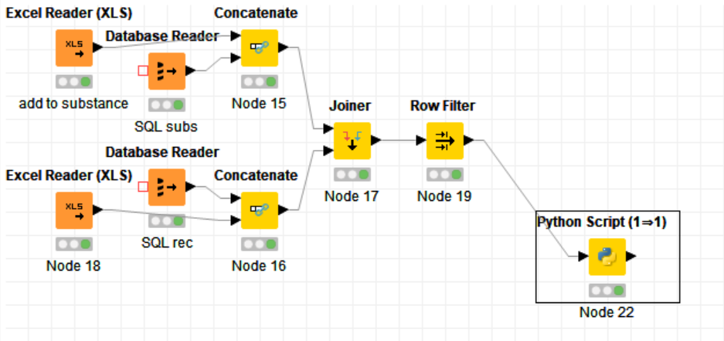
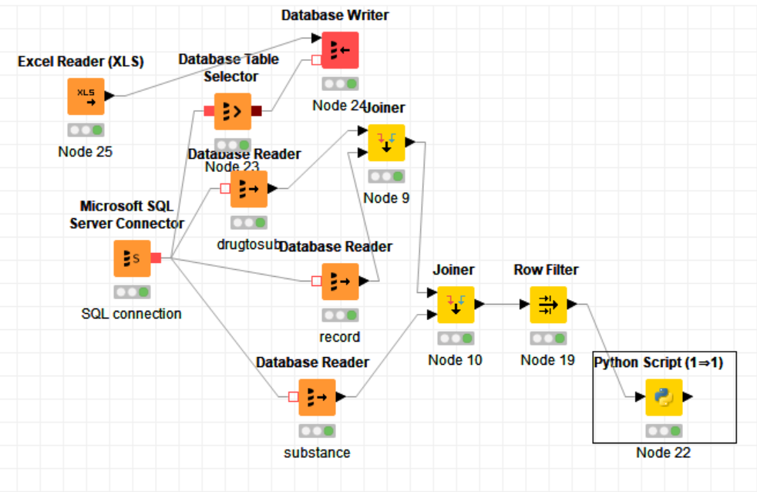
Knime workflow construction
7)Build knime workflow to connect online/local SQL server and populate the SQL database and retrieve info and generate equation model
The workflow on the top is for local SQL server.
-(Excel reader)read data from the excel with information you want to add to the SQL table(database reader)
-(concatenate)combine data
-(joiner)join different table by their primary keys
-(row filter)select specific row of info(only one request)
-(python script)take the data and form a model
The workflow at the bottom is for online SQL server.
-(Excel reader)read data from the excel with information you want to add to the SQL table(database reader)
-(MS SQL server connector)make connection to the sql server
-(database selector) choose the sql table you want to append info to and make combination(by database writer)
-different table required is read(database reader) and joined(joiner) and filtered(row filter)to get the equation graph (python script)

Slide 21
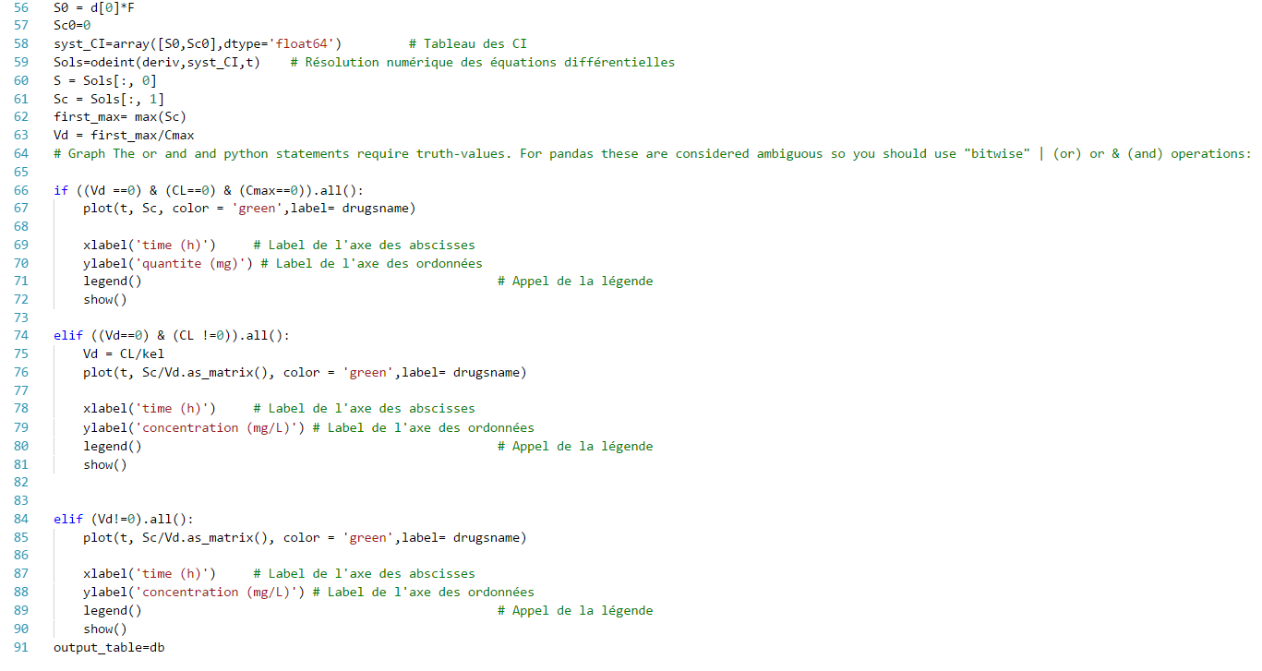
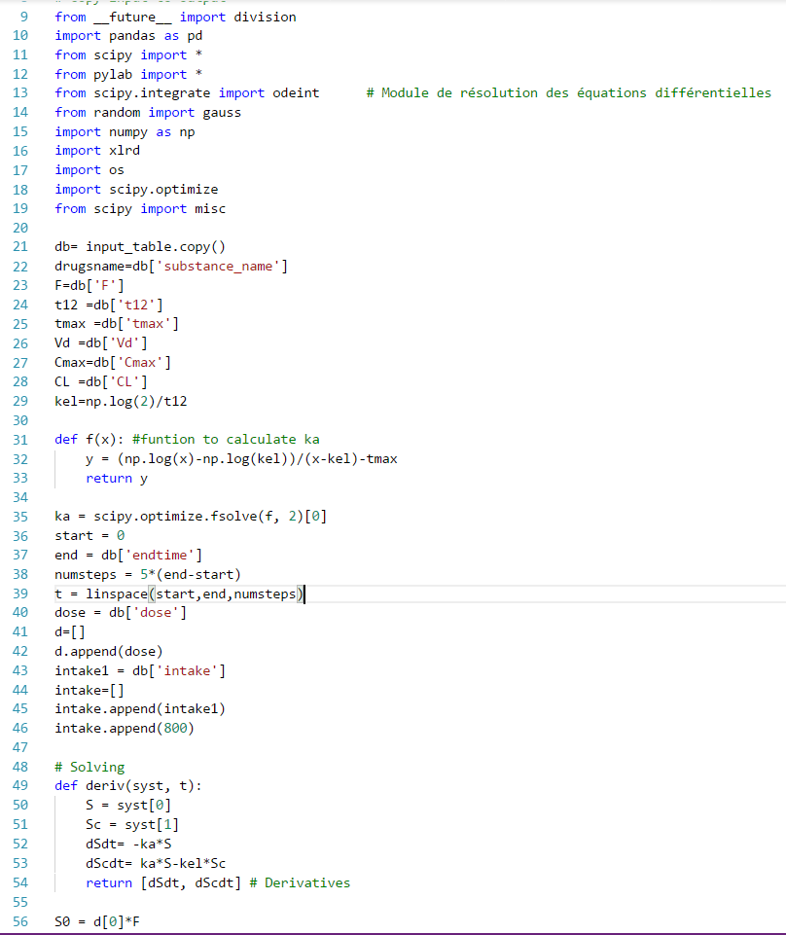
Knime workflow construction
7.1)Python extension and code to generate a graph of RCP modelling
The following code is to generate a graph of the RCP equation especially for the knime python(1--1) node. You have to install python extension to knime for it to work.
Line 21 is to get the data from previous node and import to this python script in dtaframe(pandas) format.
Line 91 is to output the dataframe.
output = graph
Node input=dataframe(from table of previous table)
Node output

Slide 22
Acknowledgement
The internship opportunity I had with ExactCure was a great chance for learning and professional development. I would like to express my deepest gratitude and special thanks to Sylvain Benito who despite being extraordinarily busy with his duties, took time out to arrange the administrative matters for my internship, hear, guide and keep me on the correct path and allow me to carry out my project.
I express my deepest thanks to Mattieu Basset, my direct supervisor, for designing my projects and giving necessary advices and guidance. I want to thank Lola Rousseau, my colleague and Fabien Astic, the president, and all my other colleagues and supervisors for showing hospitality and care for me throughout my stay in Nice.
I perceive this opportunity as a cheerful and fulfilling one. Hope that I could continue cooperation with ExactCure in the future.

